Slide 1
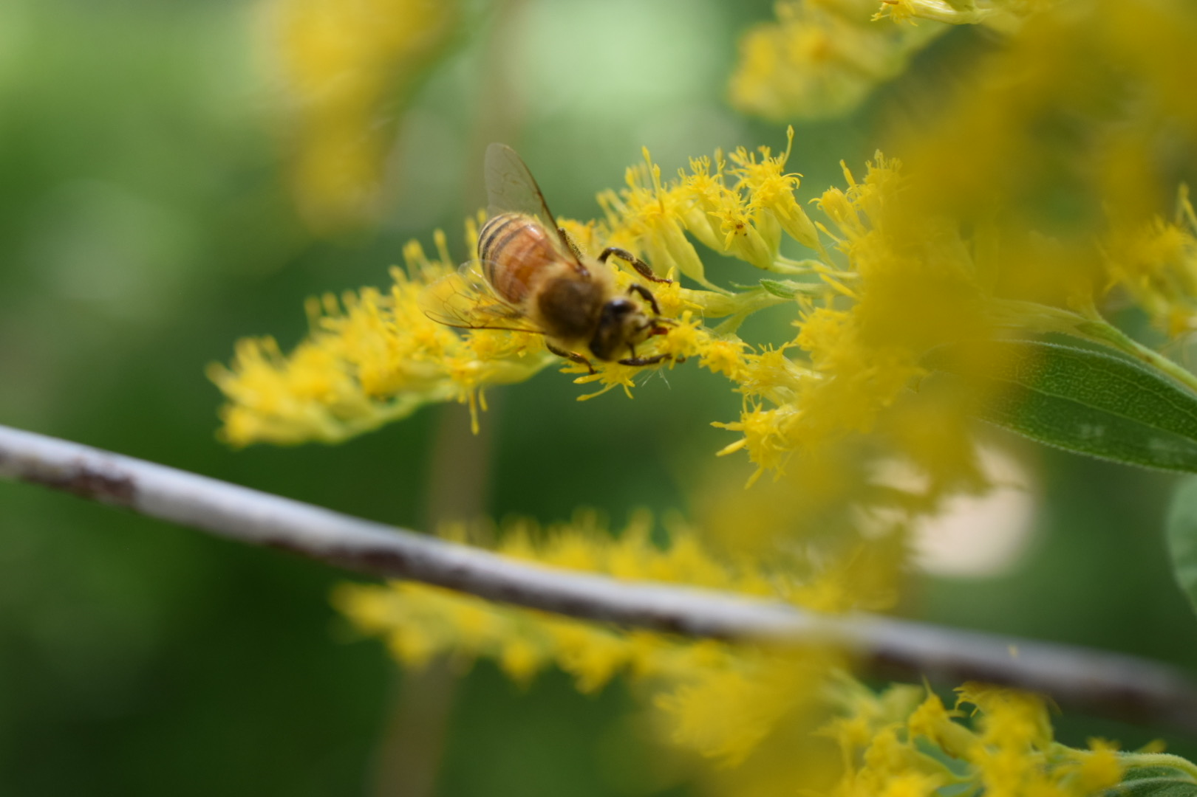
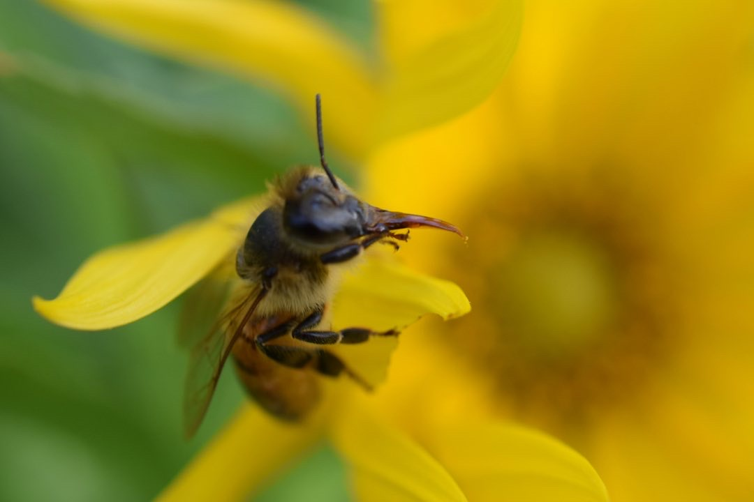
Characterizing Honeybee Colony Dynamics Using Data Analytics: Preliminary Results
Kurt B. Ferreira, Ph.D
NMBKA, Certified Beekeepers Program
15 Oct. 2022.

Slide 2
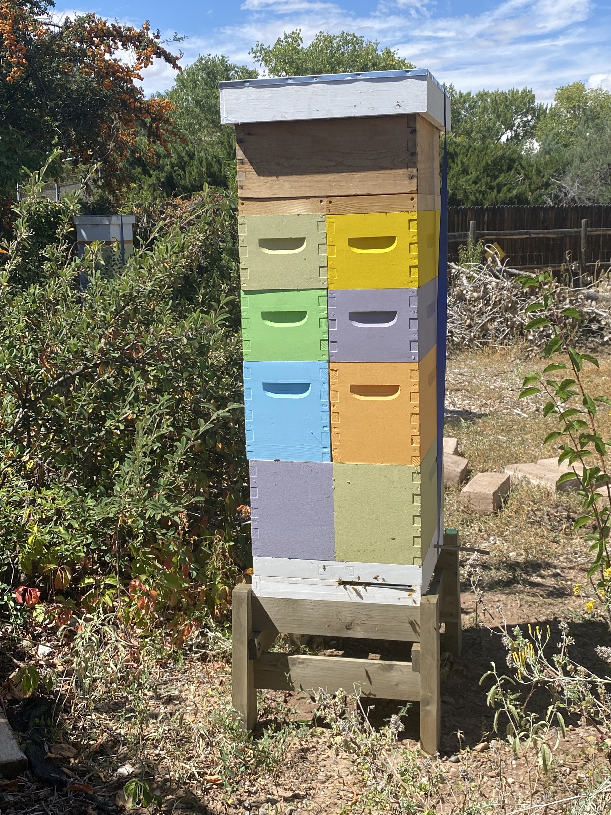
Goals
Characterize colony dynamics using hive sensor devices
Answer questions on:
Winter honey consumption
Strength of flow
Forager field force size
Robbing events
Swarm prediction
Utilize standard “big data” analytics methods
Ultimate goal, early warning system for urgent issues

Slide 3
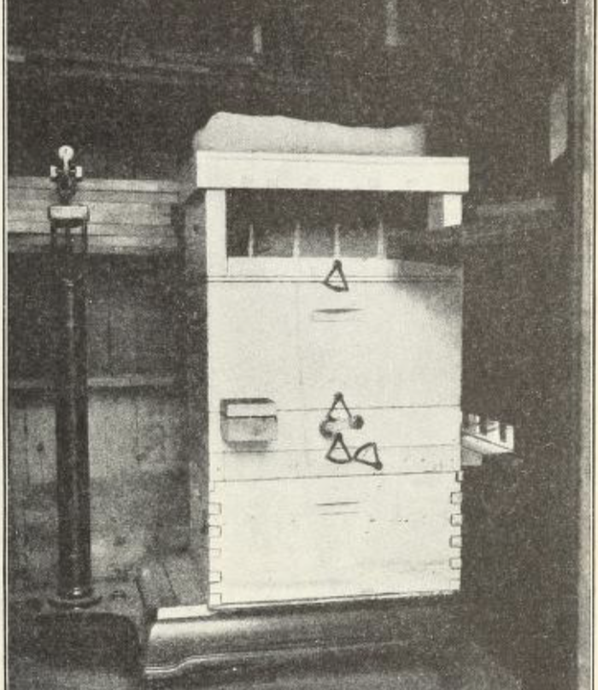
History of Hive Monitoring
Gates – 1914
Monitored temperature and weight for a year
Quantified winter honey consumption
Demonstrated winter brooding though temperature tracking
Hambleton –1925
Correlated ambient weather variables to hive weight
Ambient temperature
Relative humidity
Hours of sunshine

Slide 4
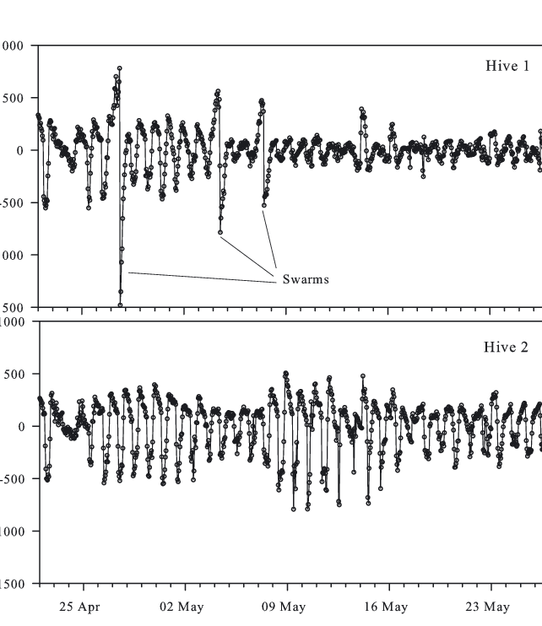
History of Hive Monitoring (cont’d)
Buchmann and Thoenes --1990
Continuous weight monitoring
Precision scale linked to a computer
Recorded data every 15 min for 1 month
Meikle et al. -- 2006, 2008
Recorded weight hourly over 16 months
Showed the effects of swarming on daily detrended data
Detected empty wooden hive daily weight change due to moisture changes in wooden hive bodies

Slide 5

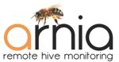





Hive Monitoring in the IoT Era
Numerous hobbyist devices
Monitor key hive metrics
External/internal temperature and humidity
Hive weight
Entrance/Exit counters
Frequency/amplitude of colony members
Vibration/Hive movement

Slide 6
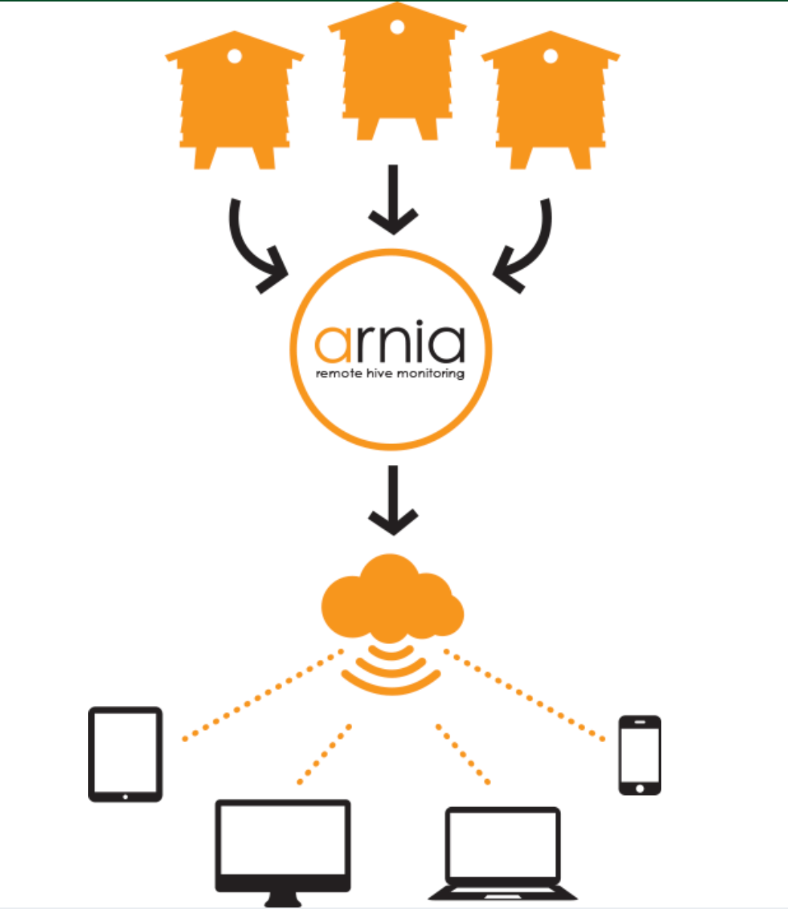

Hive Monitoring in the IoT Era (cont’d)
Clouds Storage
Careful, many user agreements state you do not own your data!
Alert notification for urgent events
Swarming/Absconding
Queen loss
Robbing
Problem: Analysis methodology questionable
Methodologies not public or peer reviewed
Lots of false positives (bi-weekly queen loss notification)
Remote
Monitoring

Slide 7



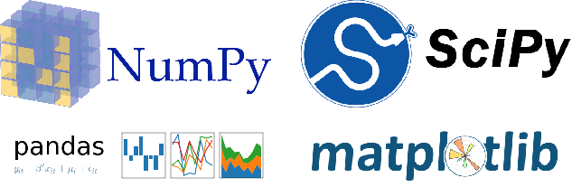

Hive Monitoring Goals
Create analysis toolkit
Process data using standard machine learning/data analytics techniques
Classify critical events, correlating sensor data to observed conditions
Compare against available vendor utilities, where possible
Toolkit details
Python: SciPy NumPy, pandas and matplotlib
Code: https://github.com/NMBKA-Cbeeks/colony_trending.git
Hive Data (to appear): https://doi.org/10.5281/zenodo.7212455

Slide 8
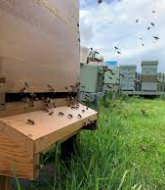
Hive Monitoring Questions?
Winter/dearth honey consumption – more accurate measure of honey needed
Flow strength – when to add/pull supers
Forager field force – how many bees are out flying?
Robbing
Detection
Rate of honey loss/gain
Swarming
Detection
Quantifying honey/bee losses

Slide 9
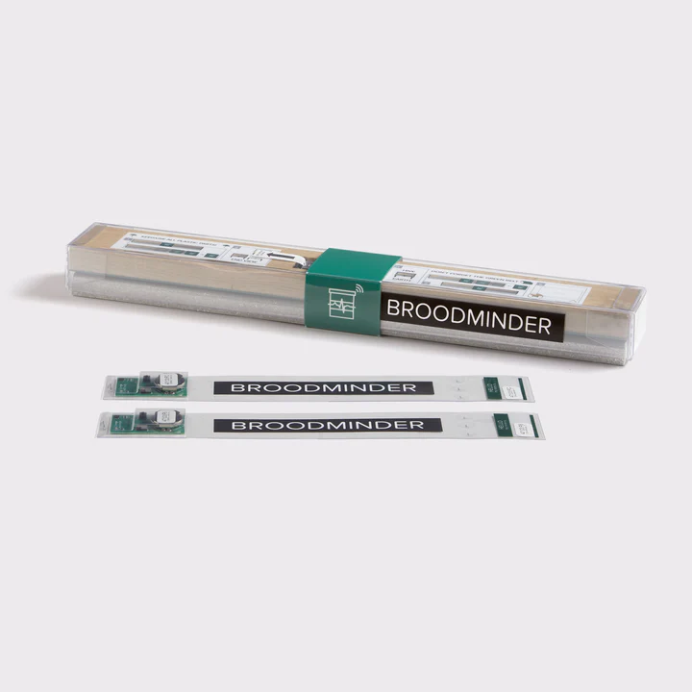
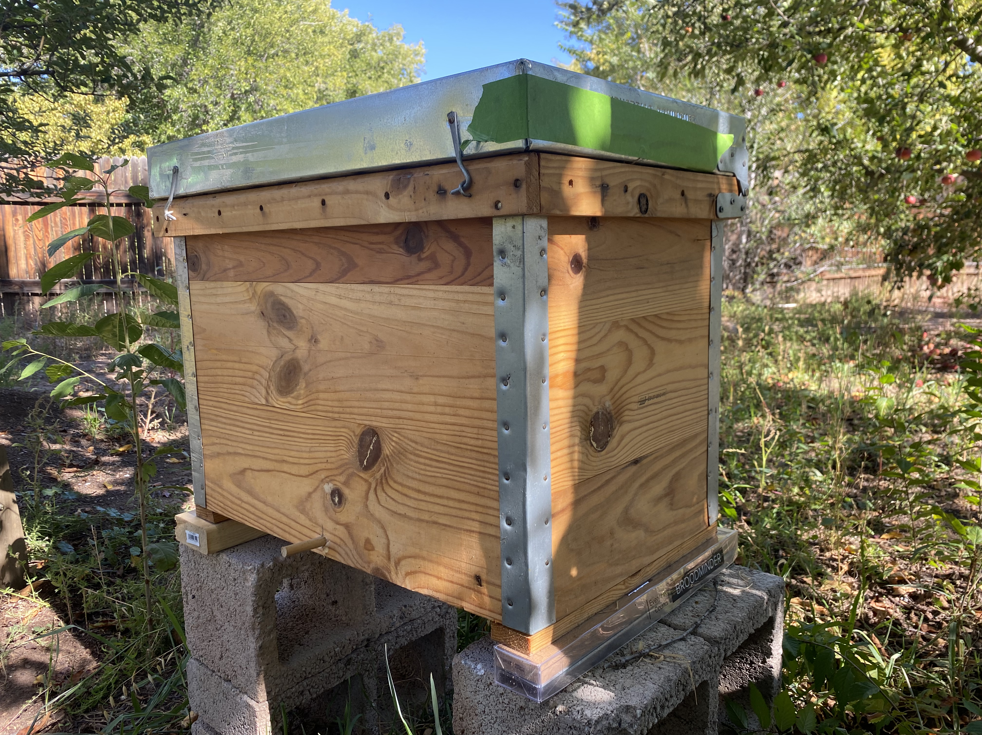
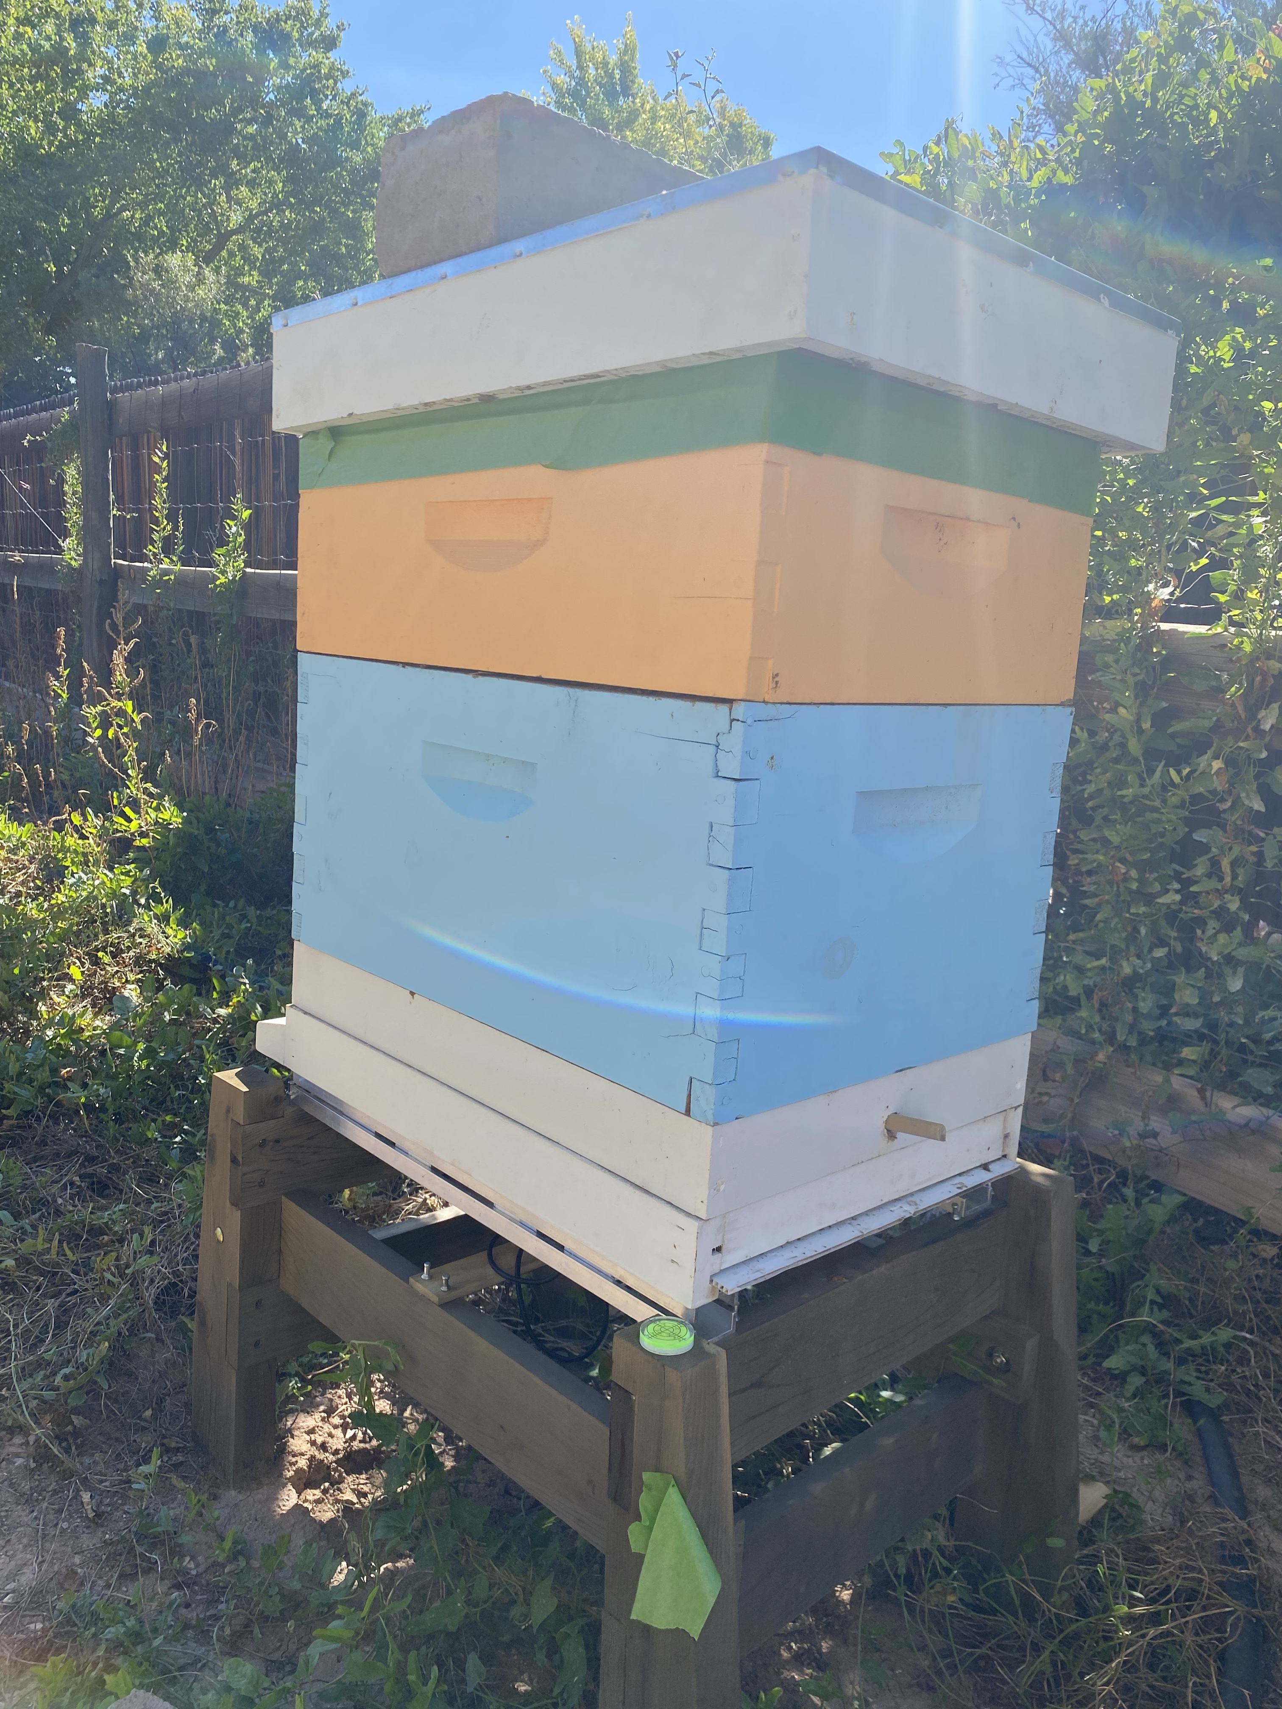
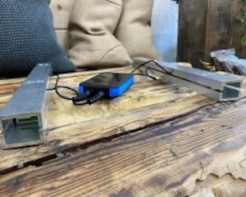
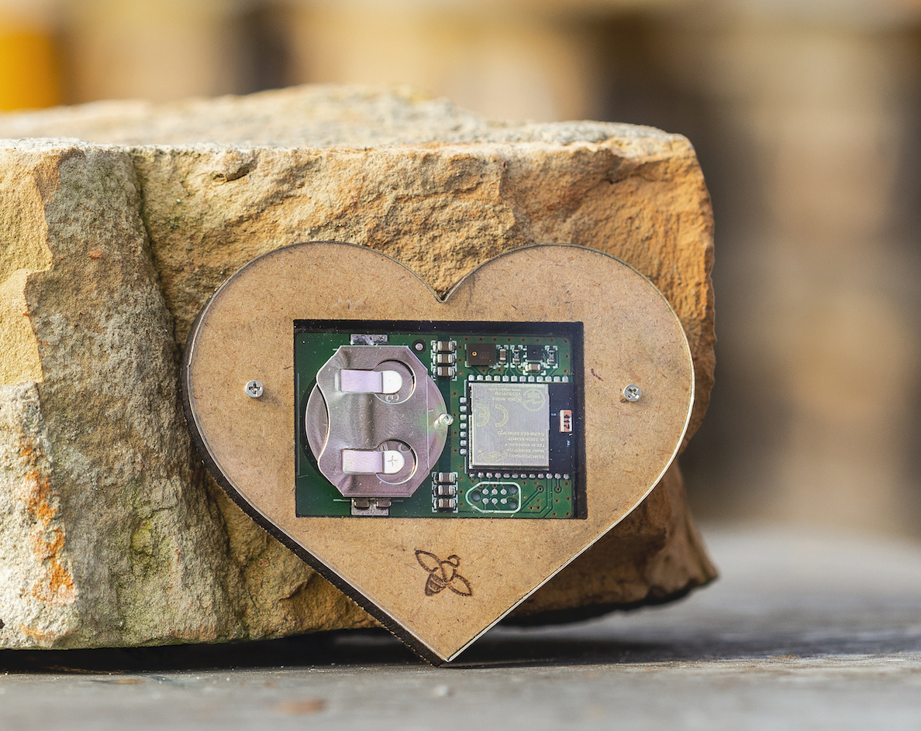
Monitoring Hardware
Broodminder
Scale under hive
Temp/Humidity sensor – inside the hive
14 frame Layens hive
Carniolans
Bee Hive Monitoring, USA
Scale under hive
Hive Heart – temperature, humidity, frequency and audio recordings
8-frame Langstroth hive
Carniolans
Bee Hive Monitoring USA

Slide 10
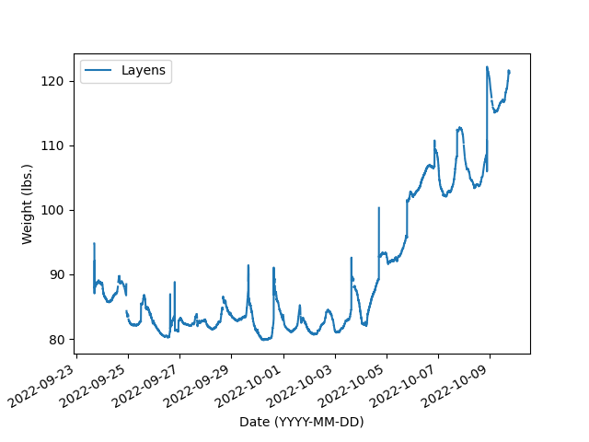
Hive Weight: Initial Analysis
Confined due to weather
Robbing event
Two+ weeks of weight data from Layens hive
Two significant events:
Confined consumption rate: 9/23 – 9/27
Robbing: 10/04 – 10/10

Slide 11
“Detrending” Data
Two components in weight data
Daily trend
Trend over dataset
Daily trend
Largely due to forager force departure and return
Termed “seasonal trend”
Use deconvolution methods to separate
Dataset trend
Largely due to the colony drying, consuming and acquiring nectar as well bee birth and death
Separate by generating a mathematical model

Slide 12
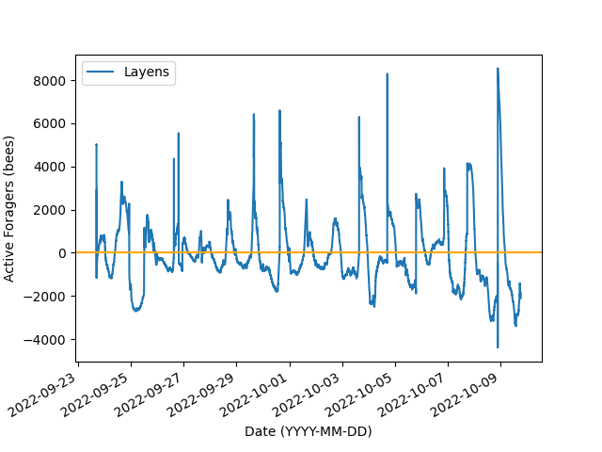
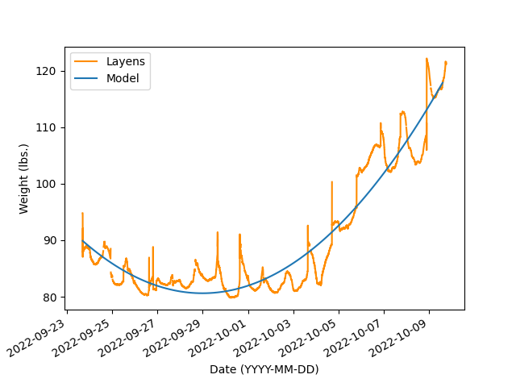
“Detrended” Data
Assumptions:
Assumes bee weights 0.11 grams
Ignores drone weight (0.2 grams)
Ignores diurnal weight changes due to water absorption/evaporation in wood
Does not account for bee death
Model can be modified to account for above, TBD

Slide 13
Active Foragers in Early fall
Field force peaks at ~8K bees
Possibility of undercounting foragers as drones weigh twice that of workers
Dips still unexplained, may be due to incorrect assumptions

Slide 14
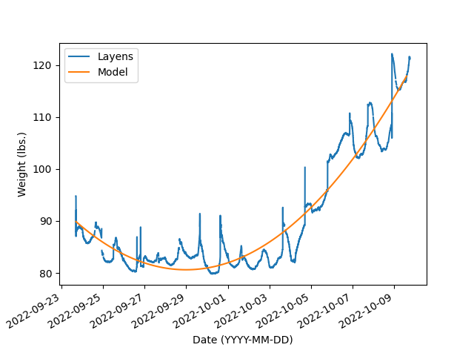
Quantifying Weight Changes
Confined due to weather
Robbing event
Two significant events occurred
Confinement: 9/23 – 9/27
Robbing: 10/04 – 10/10
Use simple polynomial regression for each interval separately.

Slide 15
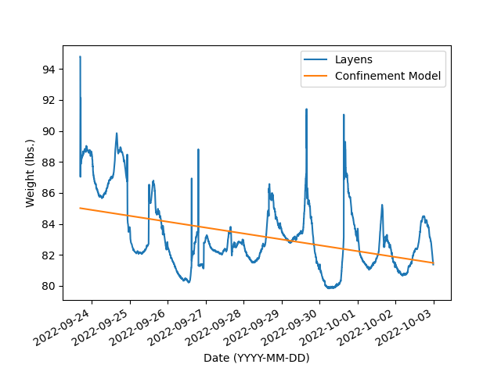
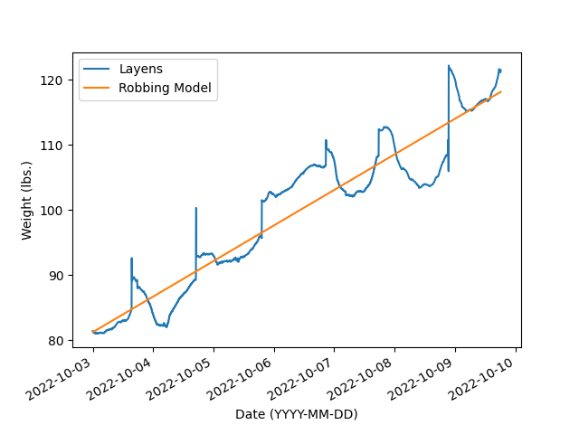
Honey Consumption and Robbing Weight Changes
Consumption during confinement: -0.38 lbs / day
Acquisition during robbing event: 5.46lbs / day

Slide 16
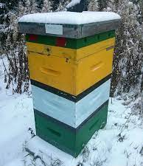
Ongoing Work
Initial work, more data needed
Complete year of data needed for statistically significant results
Additional colonies and separate genetics needed
Correlation with external metrics (precipitation, sunshine hours, internal/external temperature, etc.)
Comparison to vendor analytics

Slide 17
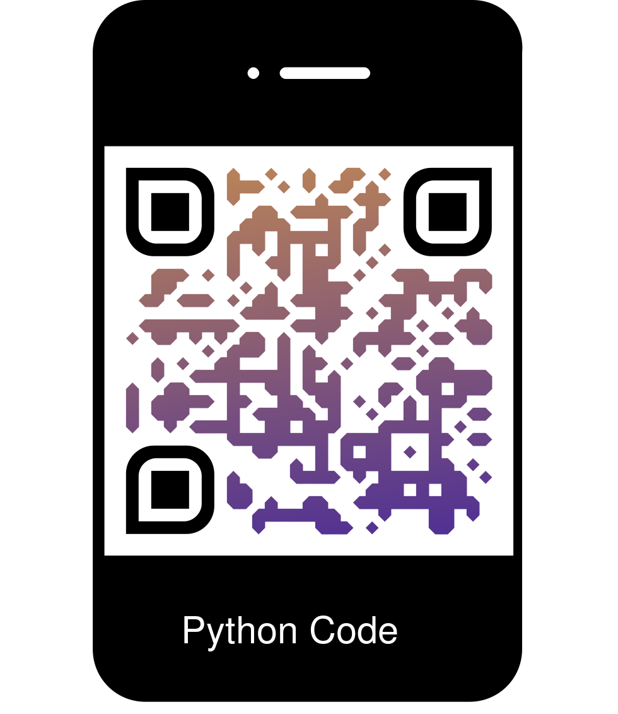
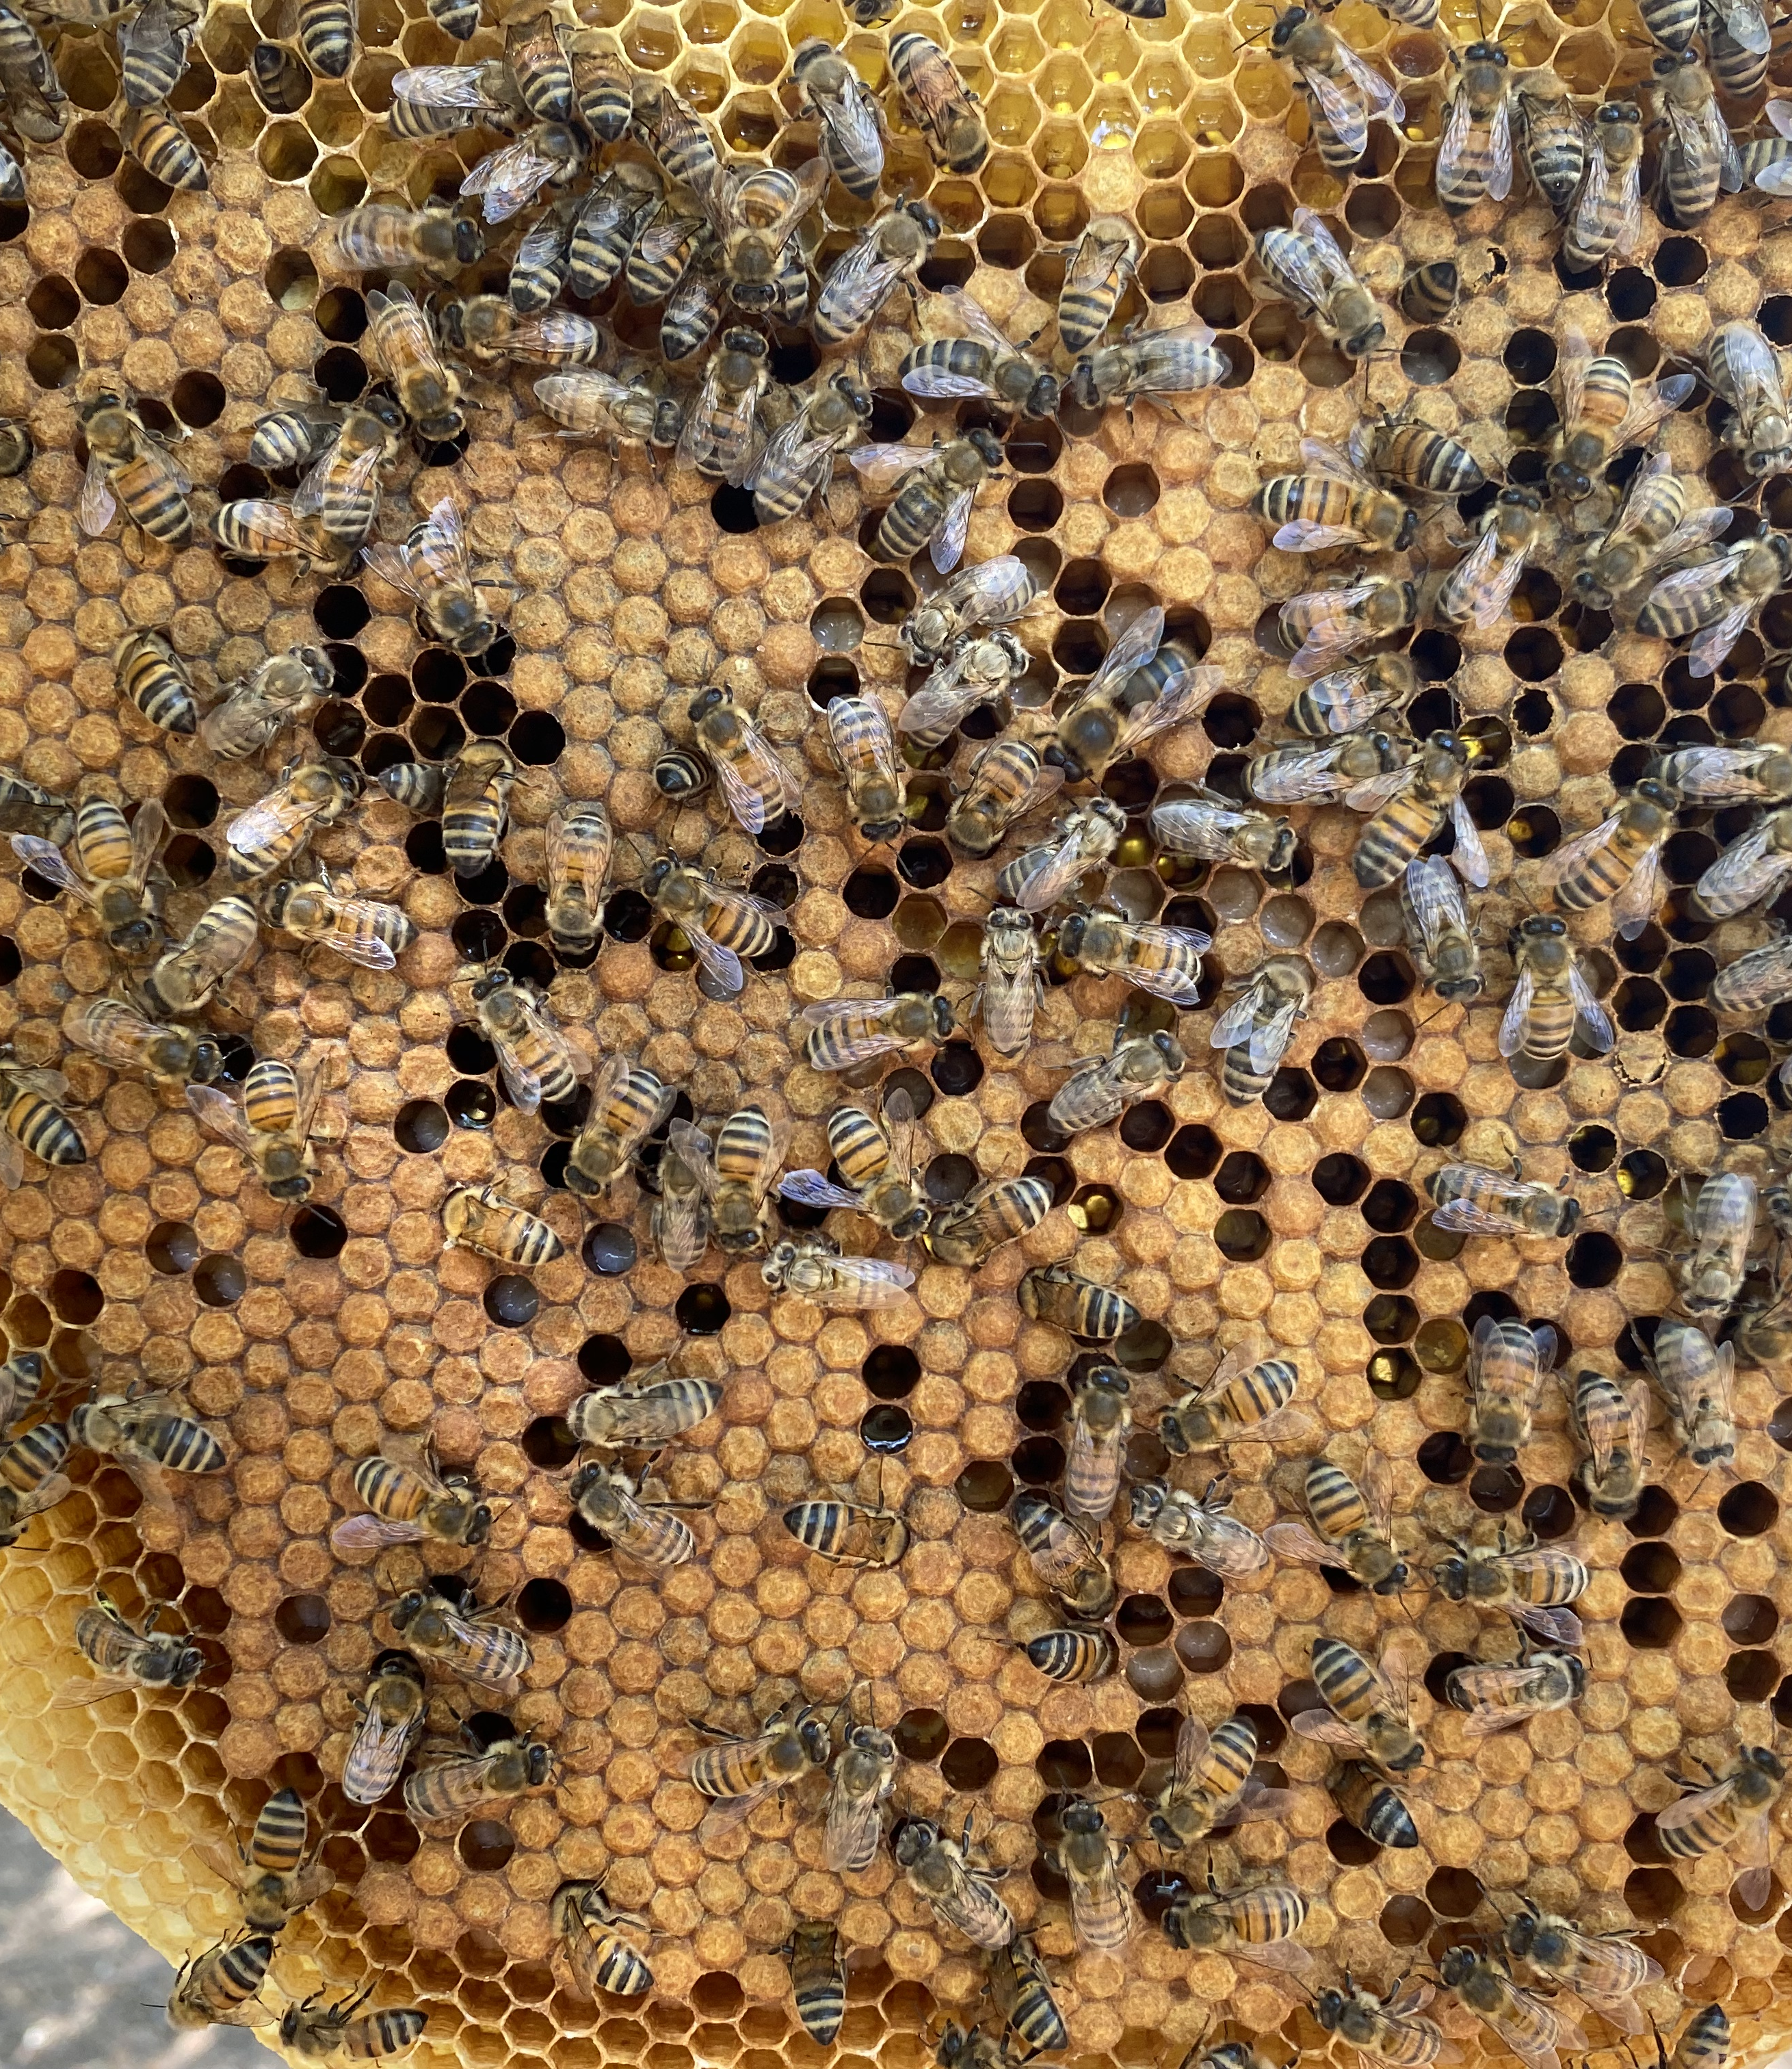
Summary
Modern IoT-based hive monitoring systems are growing in popularity
Current machine learning and data analytic methods have the potential to aid in understanding the volume of monitoring data
In this initial work, we showed the signal detrending can be used to determine a colonies foraging force.
We also show that robbing colonies can increase hive weights by ~5.5 lbs/day and a confined fall-sized colony can consume ~0.4 lbs/day of honey.

Slide 18
Detrended Weight Data
Overall Trend
Daily Trend

